Slide 1
Choose the right chart

Slide 3
Visual encoding

Slide 4
more accurate
Visual encoding ranking
less accurate

Slide 5
links
https://www.visualisingdata.com/
https://rawgraphs.io/

Slide 6
Design tips

Slide 7
Design principles
Hierarchy
Alignment
Balance
Contrast
White space
Movement
Proportion
Repetition

Slide 8
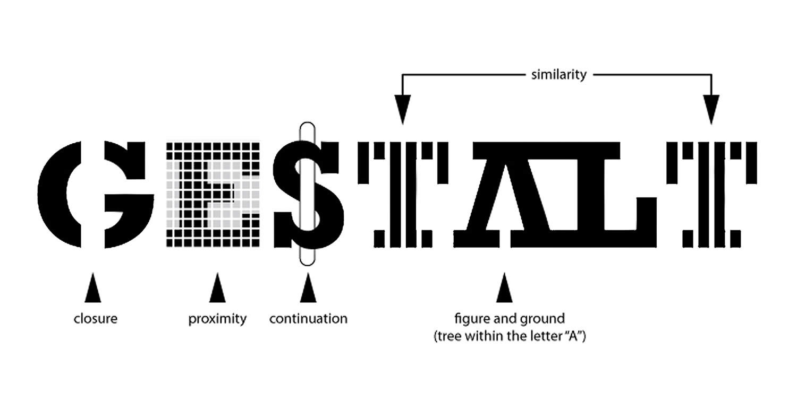

Slide 9
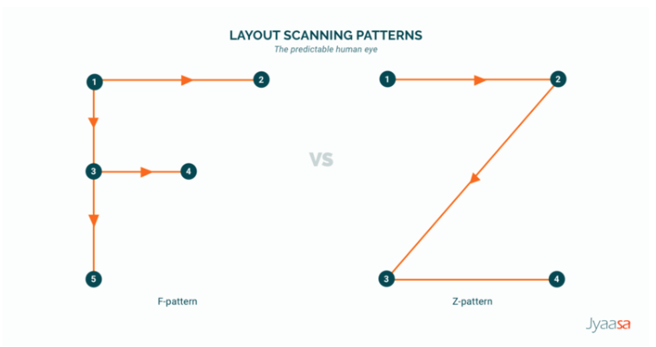
Reading patterns

